Slide 1
Capacity driven deployment
Training day 01
Chathura Kulasinghe
Solutions Engineer

Slide 2










Solutions Architecture
API-M Key-Manager
MB
API-M Gateway
ESB
API-M Store
API-M Publisher

Slide 3
Capacity Expectations
API-M Key-Manager
MB
¼ η_{(API)}
η_{(MB)}
(1- ẟ) η_{(API)}
η_{(API)}
η_{(API)}
API-M Gateway
ESB
API-M Store
API-M Publisher

Slide 4
Capacity driven deployment - ESB, for example
If an instance of WSO2 ESB handles
ω requests/transactions
within a second
to handle
η requests/transactions
within a second
A cluster of WSO2 ESB requires
n number of nodes/instances
When
n = ⌈{ η + η (30/100) } / ω⌉
and
n.ω > η + η (30/100)
+
=
LB
A₁
A₂
A₃
A_{n}

Slide 5
Capacity driven deployment - Clusters and Nodes

Slide 6
Capacity driven deployment - High availability

Slide 7
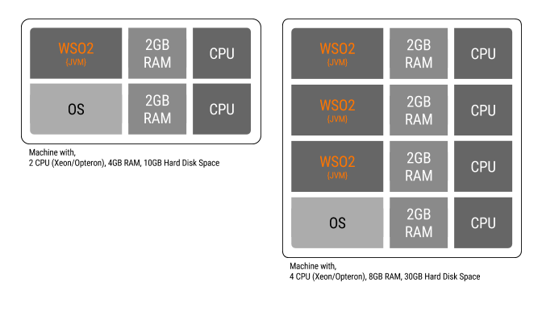
Machines/Virtual-machines

